Slide 1
Agrupamento de consenso - diceR
https://github.com/AlineTalhouk/diceR/

Slide 2
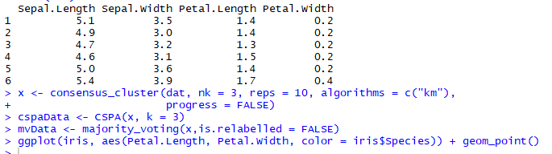
Utilizando base de dados Iris

Slide 3
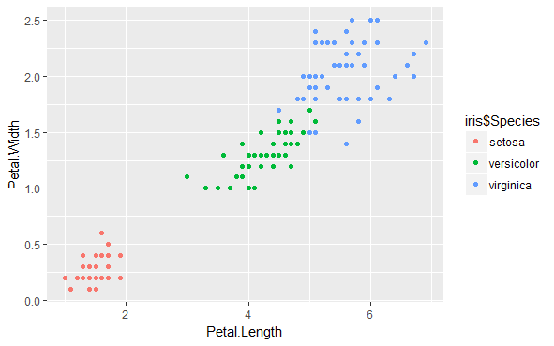
Exibindo base de dados Iris

Slide 4

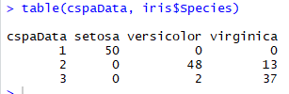
Majority_voting - CSPA

Slide 5
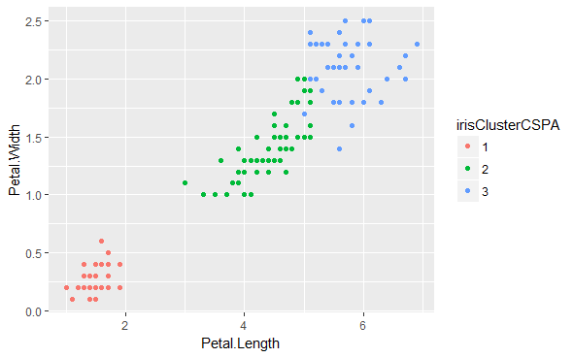
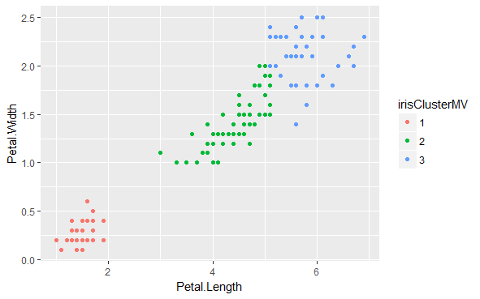
CSPA - Majority_voting

Slide 6
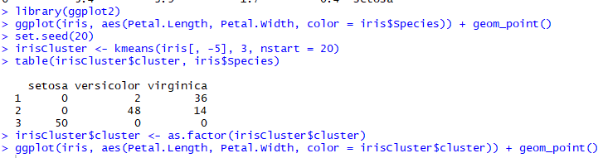
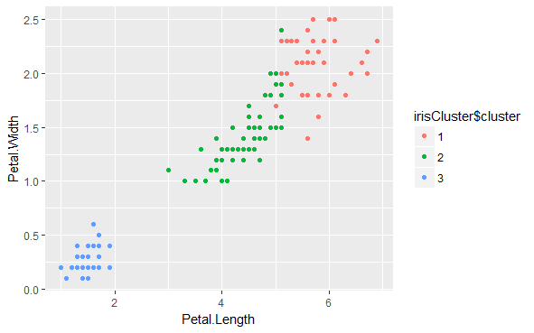
Kmeans

Slide 7

Kmeans
Majority_voting
CSPA

Slide 8
Iris
Kmeans
CSPA
Majority_voting

